Slide 1
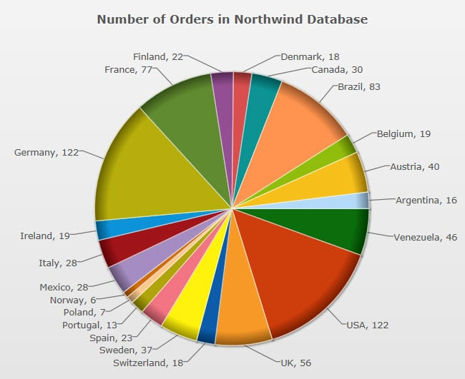
Project Title: Team Member(s): Supervisor Name: College: Department
Remember to add your details on each slide!
Instructions for inserting bullet points: Note, the box below is set up and ready for you to add your bullet points
Calibri Light font and font size 10
Bullet point spacings are set at 1
You may change the size of the box to fit your text
Add a border if preferred. Click on ‘shape outline’. Go to ‘weight’ select 1pt
To change the color of the outline, click on ‘shape outline’ and choose your outline color
Add color to the box if preferred. Click on ‘shape fill’ and select the color
Instructions for inserting paragraphs: Note, the box below is set up and ready for you to add your paragraph
Calibri Light font and font size 10. You may change the size of the box to fit your text. Add a border if preferred. Click on ‘shape outline’. Go to ‘weight’ select 1pt, To change the color of the outline, click on ‘shape outline’ and choose your outline color. Add color to the box if preferred. Click on ‘shape fill’ and select the color.
Note that in this box, color has been added and a black outline
For a box containing bullet points, use this box
Edit text, color, border and shape of box to fit your needs
For a box containing one or more paragraphs, use this box
Edit text, color, border and shape of box to fit your needs
To add a picture, use one of following methods
Go to insert, go to ‘pictures’ (for images from your computer) or ‘online pictures’ (for pictures from the internet), select the image. When inserted, change the size and location of the image. See the rectangular example above
Go to insert, go to ‘shape’, select your preferred shape, drag the ‘plus symbol’ to form your preferred shape. Double click on your chosen shape, select ‘shape fill’, select ‘picture’, chose image from file or from online. See the hexagonal example above
Options:
animations
a sound and/or musical track
transitions
Introduction

Slide 2
Project Title: Team Member(s): Supervisor Name: College: Department
Remember to add your details on each slide!
Instructions for inserting bullet points: Note, the box below is set up and ready for you to add your bullet points
Calibri Light font and font size 10
Bullet point spacings are set at 1
You may change the size of the box to fit your text
Add a border if preferred. Click on ‘shape outline’. Go to ‘weight’ select 1pt
To change the color of the outline, click on ‘shape outline’ and choose your outline color
Add color to the box if preferred. Click on ‘shape fill’ and select the color
Instructions for inserting paragraphs: Note, the box below is set up and ready for you to add your paragraph
Calibri Light font and font size 10. You may change the size of the box to fit your text. Add a border if preferred. Click on ‘shape outline’. Go to ‘weight’ select 1pt, To change the color of the outline, click on ‘shape outline’ and choose your outline color. Add color to the box if preferred. Click on ‘shape fill’ and select the color.
Note that in this box, color has been added and a black outline
For a box containing bullet points, use this box
Edit text, color, border and shape of box to fit your needs
For a box containing one or more paragraphs, use this box
Edit text, color, border and shape of box to fit your needs
To add a picture, use one of following methods
Go to insert, go to ‘pictures’ (for images from your computer) or ‘online pictures’ (for pictures from the internet), select the image. When inserted, change the size and location of the image. See the rectangular example above
Go to insert, go to ‘shape’, select your preferred shape, drag the ‘plus symbol’ to form your preferred shape. Double click on your chosen shape, select ‘shape fill’, select ‘picture’, chose image from file or from online. See the hexagonal example above
Options:
animations
a sound and/or musical track
transitions
Methods

Slide 3
Project Title: Team Member(s): Supervisor Name: College: Department
Remember to add your details on each slide!
Instructions for inserting bullet points: Note, the box below is set up and ready for you to add your bullet points
Calibri Light font and font size 10
Bullet point spacings are set at 1
You may change the size of the box to fit your text
Add a border if preferred. Click on ‘shape outline’. Go to ‘weight’ select 1pt
To change the color of the outline, click on ‘shape outline’ and choose your outline color
Add color to the box if preferred. Click on ‘shape fill’ and select the color
Instructions for inserting paragraphs: Note, the box below is set up and ready for you to add your paragraph
Calibri Light font and font size 10. You may change the size of the box to fit your text. Add a border if preferred. Click on ‘shape outline’. Go to ‘weight’ select 1pt, To change the color of the outline, click on ‘shape outline’ and choose your outline color. Add color to the box if preferred. Click on ‘shape fill’ and select the color.
Note that in this box, color has been added and a black outline
For a box containing bullet points, use this box
Edit text, color, border and shape of box to fit your needs
For a box containing one or more paragraphs, use this box
Edit text, color, border and shape of box to fit your needs
To add a picture, use one of following methods
Go to insert, go to ‘pictures’ (for images from your computer) or ‘online pictures’ (for pictures from the internet), select the image. When inserted, change the size and location of the image. See the rectangular example above
Go to insert, go to ‘shape’, select your preferred shape, drag the ‘plus symbol’ to form your preferred shape. Double click on your chosen shape, select ‘shape fill’, select ‘picture’, chose image from file or from online. See the hexagonal example above
Options:
animations
a sound and/or musical track
transitions
Results

Slide 4
Project Title: Team Member(s): Supervisor Name: College: Department
Remember to add your details on each slide!
Instructions for inserting bullet points: Note, the box below is set up and ready for you to add your bullet points
Calibri Light font and font size 10
Bullet point spacings are set at 1
You may change the size of the box to fit your text
Add a border if preferred. Click on ‘shape outline’. Go to ‘weight’ select 1pt
To change the color of the outline, click on ‘shape outline’ and choose your outline color
Add color to the box if preferred. Click on ‘shape fill’ and select the color
Instructions for inserting paragraphs: Note, the box below is set up and ready for you to add your paragraph
Calibri Light font and font size 10. You may change the size of the box to fit your text. Add a border if preferred. Click on ‘shape outline’. Go to ‘weight’ select 1pt, To change the color of the outline, click on ‘shape outline’ and choose your outline color. Add color to the box if preferred. Click on ‘shape fill’ and select the color.
Note that in this box, color has been added and a black outline
For a box containing bullet points, use this box
Edit text, color, border and shape of box to fit your needs
For a box containing one or more paragraphs, use this box
Edit text, color, border and shape of box to fit your needs
To add a picture, use one of following methods
Go to insert, go to ‘pictures’ (for images from your computer) or ‘online pictures’ (for pictures from the internet), select the image. When inserted, change the size and location of the image. See the rectangular example above
Go to insert, go to ‘shape’, select your preferred shape, drag the ‘plus symbol’ to form your preferred shape. Double click on your chosen shape, select ‘shape fill’, select ‘picture’, chose image from file or from online. See the hexagonal example above
Options:
animations
a sound and/or musical track
transitions
Conclusion

