Slide 1
Tell me & I’ll forget
Teach me & I’ll remember
Engage me & I’ll learn
- Chinese Proverb

Slide 2


Education Has Changed.
So Have We.
Notes:
Many of you know McGraw-Hill as simply a book publishing company. However as education is evolving, we realize we need to become something more. We need to hold the success of the learning at the center of everything we do for a few reasons…
Teaching and learning are part art, part science. Every day, educators bring a wealth of passion, dedication and expertise to help students achieve success. At McGraw-Hill Education, we help them drive results by delivering technology that harnesses an understanding of how the mind works to make each learning moment more engaging, efficient and effective. Learning has the power to change the world. We inspire that change,
one person at a time, by making the science of learning work for you. Simply.

Slide 3

Living by the Four E’s
    Easy to use
    Engaging
    Efficient
    Effective
Notes:
As we transition to learning science, we need to make sure, and are asking the questions– is our product easy to use? Does it engage its audience? Is it efficient? Is it effective?

Slide 4
Proven Results
Notes:
We have two core digital products. Connect and Aleks. Connect is our cms which is heavily integrated within black board and allow a complete course management system via the use of ebooks online assessments / quizzes and analytical reporting
This is our flagship product which most of you will already be aware of and is currently being heavy used across the middle east as well as the rest of the world.
If anyone would like to know more about connect, I can certainly awnser questeions at the end or alternatibvly you can come visit me on our stand.

Slide 5
What is Adaptive Technology?
Assessments and instruction are tailored to each individual student based on their strengths and weaknesses.
Artificial intelligence constantly measures retention of topics learned.
Struggling students get exactly the support they need to be successful. Stronger students are only presented with material they need to learn to reduce repetition.
Faculty can ensure that every student in their class is receiving the support they need.
Notes:
Play video

Slide 6
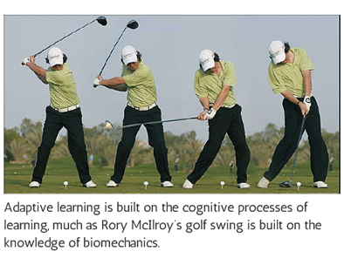
Power of Adaptive Learning
Based on educational theory and cognitive science
Personalizes learning by continually assessing students’ knowledge, skill and confidence levels
Notes:
Adaptive learning – the benefits
Students are more engaged
Better grades, higher retention
Instructors get to focus on what they love most, teaching
Based on educational theory and cognitive science
Personalizes learning by continually assessing students’ knowledge, skill and confidence levels
Designs targeted study paths that help students improve in their areas of weakness and retain competencies
Students study more effectively and productively

Slide 7

What is ALEKS?
ALEKS is an adaptive online system that delivers an individualized learning experience tailored to students’ unique strengths and weaknesses.
Notes:
By tailoring itself in this way, ALEKS allows faculty to support struggling students without slowing down the whole class. Now faculty can .ensure that 100% of their students are getting the support they need to be successful

Slide 8
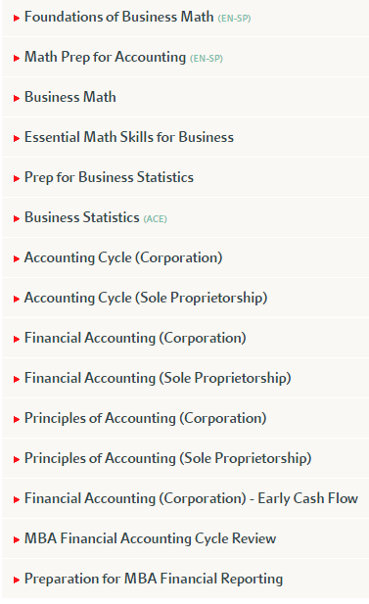
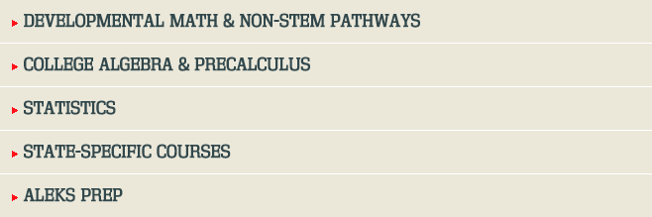
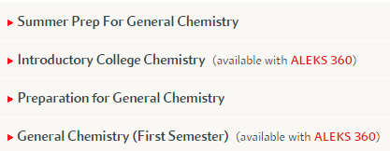

ALEKS Subject Offerings
Notes:
By tailoring itself in this way, ALEKS allows faculty to support struggling students without slowing down the whole class. Now faculty can .ensure that 100% of their students are getting the support they need to be successful

Slide 9
How does ALEKS work?
Born from NSF-funded research by mathematicians and cognitive scientists from UC Irvine and
Is the practical realization of Knowledge Space Theory, the field of study in mathematical cognitive science developed by the founder of ALEKS
Over a decade of data collection has refined the system to be highly accurate in measuring student knowledge and improving learning outcomes
Notes:
Do not spend too much time on the science here as it does get complicated. If people would like to learn more about how ALEKS was created and read the published research on Knowledge Space Theory, they can find it all at www.ALEKS.com. Once there, click on the “What is ALEKS?” link.

Slide 10
What are the core challenges in the class?
Student Preparedness
Students Learn at Different Paces
Inconsistency between Homework and Test Scores
Ensure Students are Ready for Topics
ALEKS was created to
address these core challenges.
Notes:
Students arrive at class with a wide variety of prerequisite knowledge. It is extremely difficult for a professor to know exactly what areas students need help with to be successful. ALEKS will tell them exactly what students need to cover to be ready to succeed.
Every student is different. How do you support struggling students without slowing down the whole class? ALEKS will provide students with exactly the help they need to succeed. For example, a struggling student may have 10 topics to cover in a week, while a stronger student would only have to focus on the two topics he/she had not yet mastered.
Do you ever find that students perform well on homework but that performance is not reflected in tests? Why do you think that is? We’re going to explore how we can get a greater synergy between homework and test performance.
The worst thing for a student’s motivation is to attempt material they are not prepared for or to get bored with material they already know. It’s very difficult to ensure students are always prepared for the next piece of work. We’ll dive into this too.

Slide 11
1. Student Preparedness
Students arrive in the course with a wide variety of prerequisite knowledge.
What if you could see on day one of the course exactly what each student knows and what they don’t know?
Notes:
How do you currently identify what students know and have forgotten from their previous courses? Is that accurate? What happens when a student is underprepared?

Slide 12
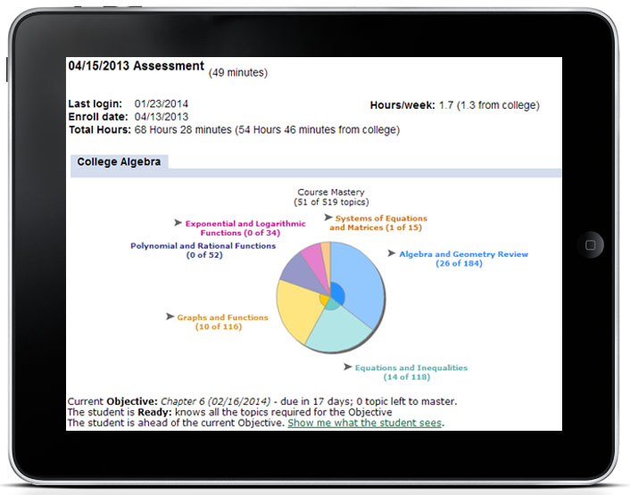
ALEKS Initial Assessment
An adaptive assessment that measures exactly what students know, don’t know, and more importantly, what they are ready to learn
Now you can see on day one what each student needs to learn.
Notes:
The ALEKS Initial Assessment is a 25-30 question, adaptive assessment that will measure exactly what students know and don’t know in a given course curriculum. Because it is adaptive, every student gets a different set of questions based on their performance. If a student answers questions right, they get progressively more challenging. If they get them wrong, it will decrease in level. This continues until the system can pinpoint what the student knows, doesn’t know, and more importantly, what he/she is ready to learn; otherwise known as their “Knowledge State”. As an instructor, this enables you to identify which students are underprepared and need more support and which content they should focus on. It also allows you to see students that perhaps have been placed too low and are ready for a more advanced course, saving them a semester of work!

Slide 13
2. Students Learn at Different Paces
Some students need additional support to master certain topics.
How do you support struggling students without slowing down the whole class?
Notes:
To try to provide each student with the support they need without disadvantaging the rest of the class is a significant challenge. How do you ensure that struggling students get the help they need without overburdening stronger students with excess work?

Slide 14
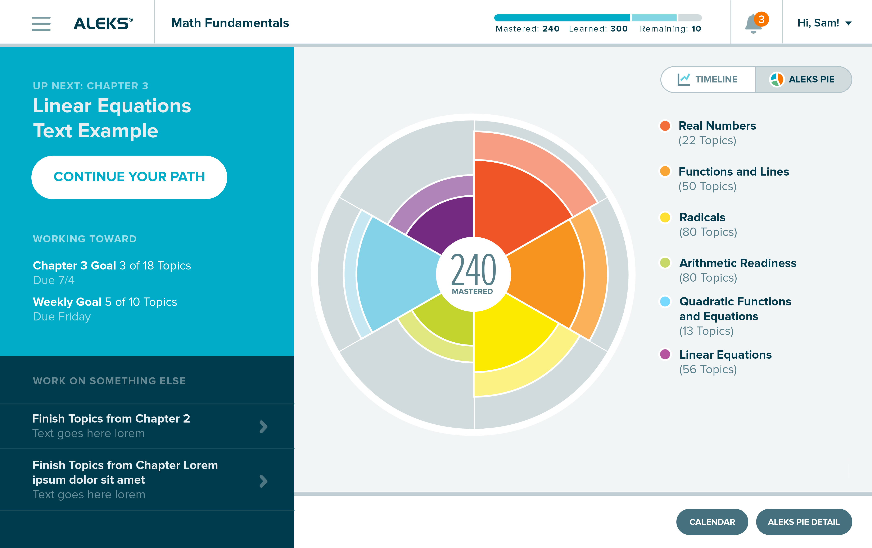
ALEKS Adaptive Learning
Struggling students are given the help they need to
succeed without slowing down the class.
Notes:
By constantly adapting, ALEKS determines exactly where students need support and delivers the exact material they need. This means weaker students get the support they need to be successful and stronger students are able to quickly progress through material without having to waste time on material they already know.

Slide 15
3. Inconsistency between Homework and Test Scores
Do your students perform better on homework than on tests?
How can you ensure that students don’t game the system?
Notes:
Do you ever see instances where students do well on homework then badly on tests? Why is that? Is it test phobia? Is it an over-reliance on help functionalities? With some systems, students are quickly able to see that by mimicking the guided examples, but simply replacing the numbers, you can follow the process and get answers correct. This results in high homework scores, but a false impression of what a student really know. They are gaming the system and their learning suffers as a consequence. Other systems rely on the “drill and kill” method, which doesn’t actually ensure students are mastering what they are learning.

Slide 16
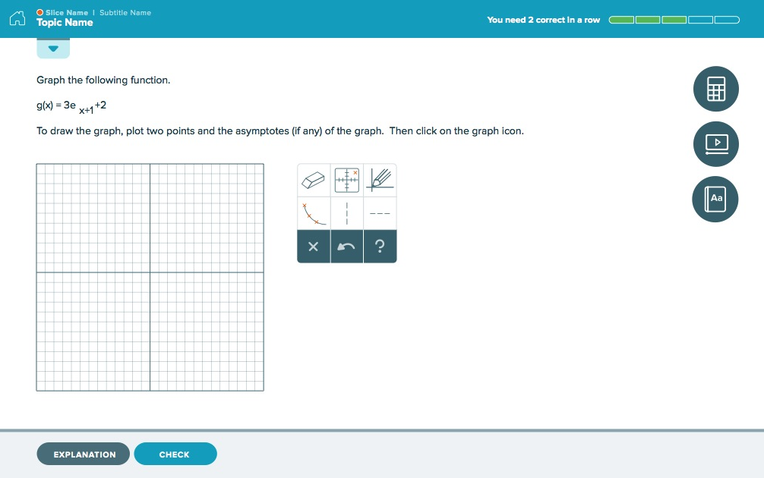
Learning vs. Memorizing
Problem structures change to prevent students from copying learning aids and gaming the system.
Students must answer questions correctly multiple times to prove they have learned the concept.
Notes:
ALEKS eliminates the possibility of students gaming the system in a few ways. 1. ALEKS doesn’t rely on multiple-choice questions, reducing the possibility of students guessing. 2. ALEKS changes each question in such a variety of ways that students have to prove they understand the concept behind the problem rather than memorize a process. For example, we change the order of equations, introduce negative, introduce fractions where appropriate, all to ensure that when a student answers a question correctly, we can be more confident they truly know the concept behind it. The final way ALEKS ensures understanding is by periodically re-assessing students to ensure that what they have learned is retained. The system can then pinpoint what the student has forgotten or needs additional help on, and will guide the student to focus on those areas.

Slide 17
4. Ensure Students are Ready for Topics
If students try material they are unprepared for, it causes frustration and becomes a roadblock.
If students are only presented with material they are Ready to Learn, confidence is boosted and success rates are higher.
Notes:
When homework is delivered in other ways, even paper and pencil, you would traditionally assign, as an example, 10 homework questions per week. A student may get 8 of these questions right (80%) and feel they are performing well within the course. However the 2 topics they miss are often the most challenging and can also be prerequisites for future topics. At no point is a student alerted that one of the questions they got wrong is fundamental to their future success. So they’ll get 80%, 80%, 80%, then they get a homework that requires the prerequisite content they missed and all of a sudden they tank. This destroys motivation and often is the point at which students are lost. The purpose of homework is to ensure students are learning and retaining material; by only showing each student what he/she is Ready to Learn, the motivation is never lost.

Slide 18
ALEKS Ready to Learn
Students are only presented with topics if they have proven mastery of the related prerequisites.
This is proven to boost motivation, reduce frustration, and increase student success.
Notes:
ALEKS never presents students with content they have not demonstrated they are Ready to Learn; students must proven mastery in the prerequisite topics first. This is a huge boost in motivation for students, it allows them to progress through the course faster and ultimately improves overall success of your class.

Slide 19
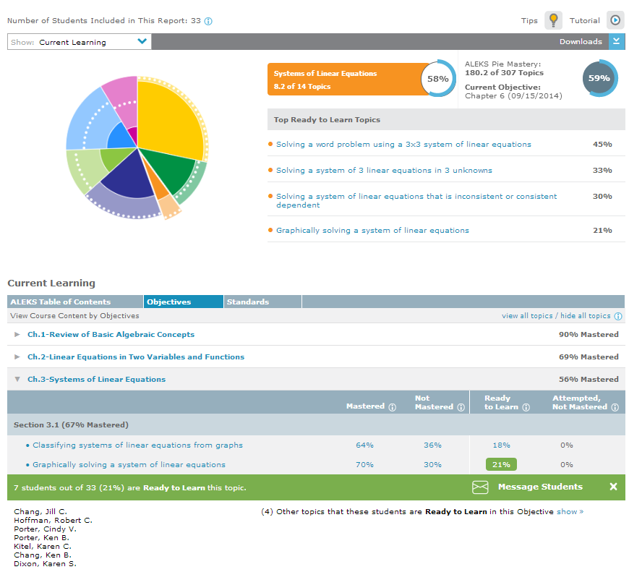
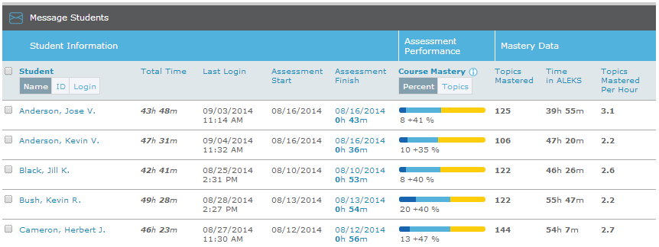
ALEKS Reports
ALEKS reporting is extremely powerful, allowing you to closely monitor students and use the data to inform your teaching.
Notes:
ALEKS has some of the most insightful reporting of any software. It measure and reports real time on exactly what students are doing within the system. What are they working on, what are they inputting, where are they struggling, which students are at risk? etc. With this data, it enables you as an instructor to teach exactly what students need, when they need it. Rather than covering the same review at the beginning of class, now you can review just the topics students are struggling with, speeding up your progress through the curriculum.

Slide 20
Why choose ALEKS?
By adapting to each student, 100% of your class gets the individual support they need.
With powerful reporting, you can measure exactly where your class needs support and constantly monitor progress.
It is proven to significantly improve student performance.
Notes:
For more information about ALEKS and to view success stories, visit www.successinmath.com

Slide 21

Q&A

