Slide 1
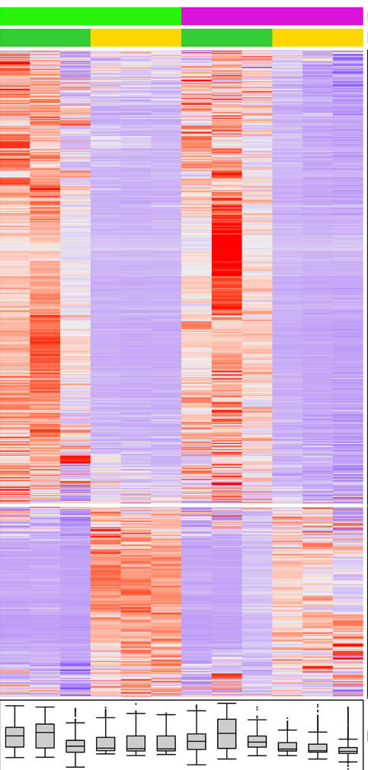
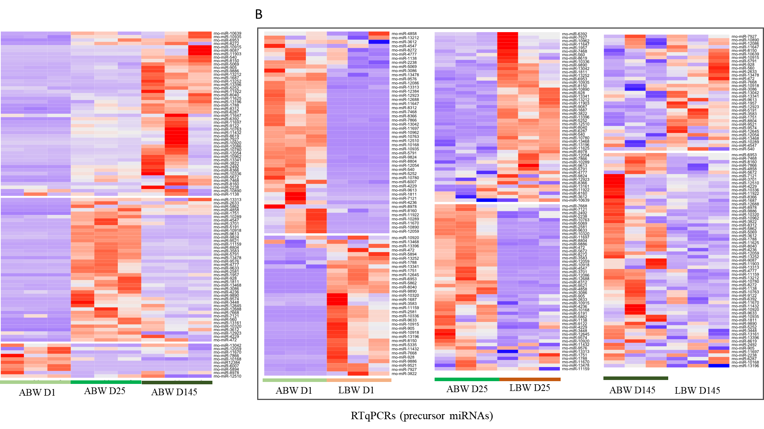
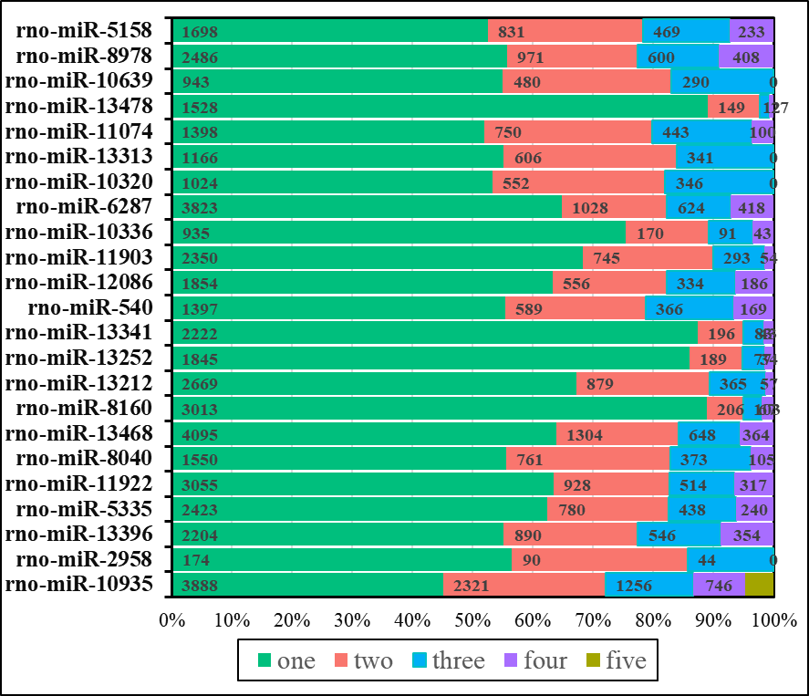
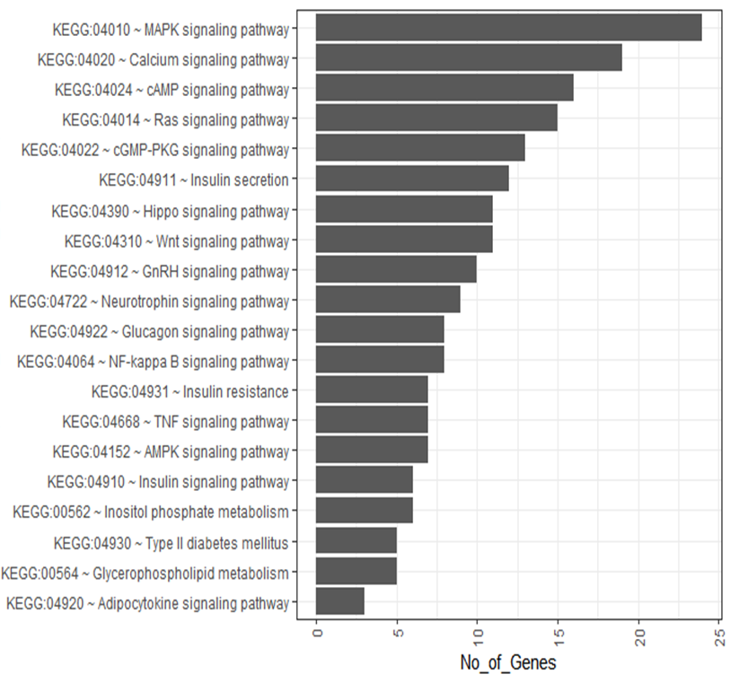
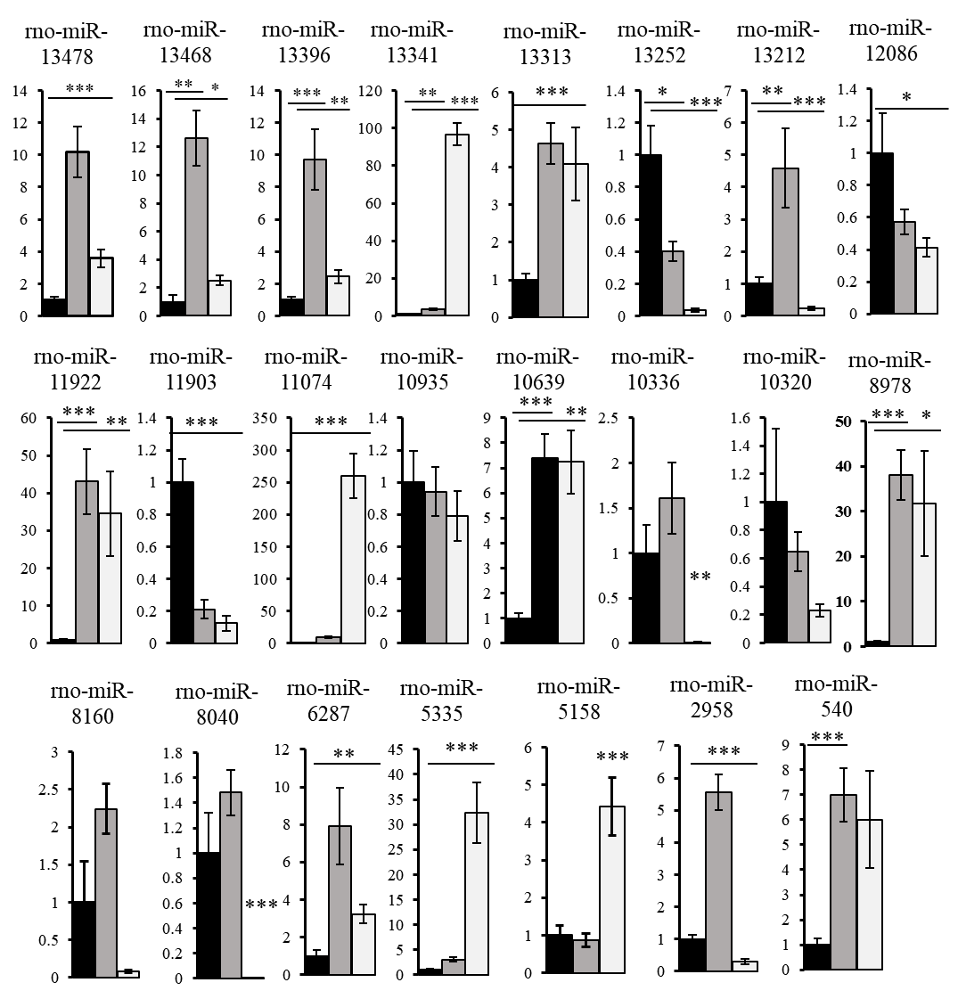
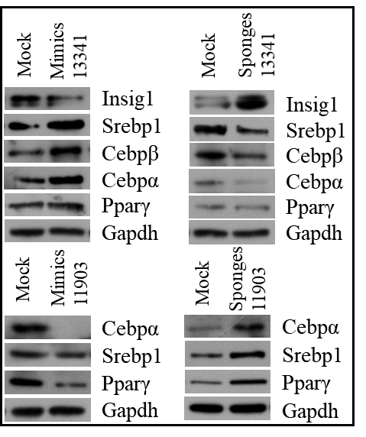
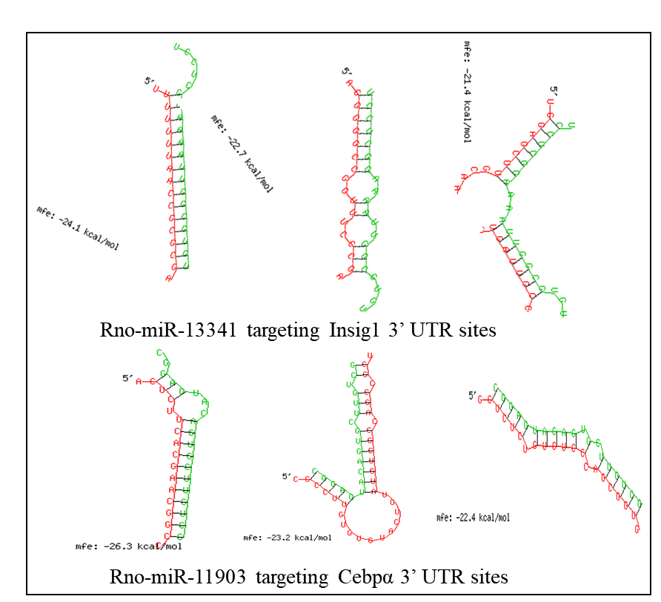
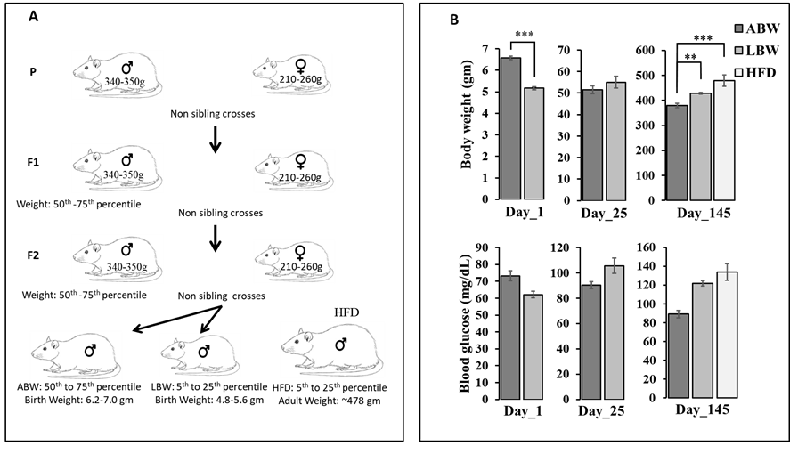
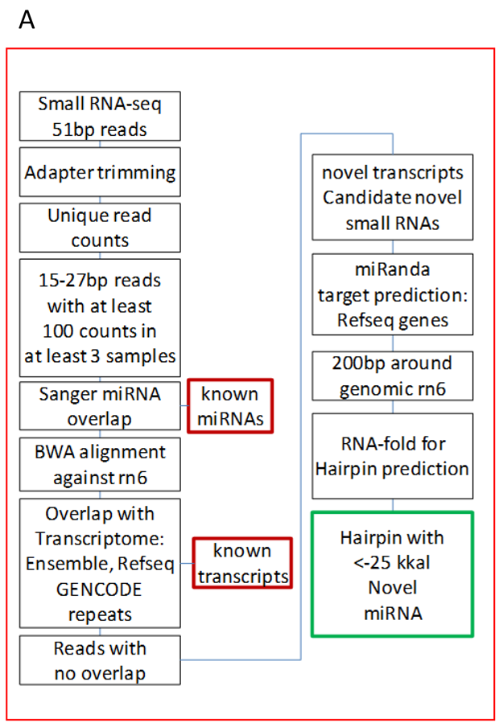
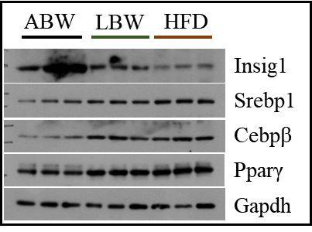
Genome-wide small RNA sequencing analysis identifies novel microRNAs expressed during development and are altered in obesity
Challagandla AK (Graduate), Kaimala S, Daniel AP, Sreedharan SP, Emerald BS
Department of Anatomy, College of Medicine and Health Sciences, United Arab Emirates University, Al Ain, Abu Dhabi, UAE
Introduction
A
B
C
MicroRNAs (miRNAs) are ~21bp long regulatory RNAs and involves in the regulation of cellular pathways by targeting associated mRNAs. They regulate all known cellular functions such as development, differentiation and metabolism and dysregulation in their expression have been linked to different diseases including metabolic diseases such as obesity and type 2 diabetes. Even though rat is a well-established model system for metabolic studies and the relevance of miRNAs as regulators of metabolism is well established, very few miRNAs have been identified in rat, compared to humans and mouse. We carried out a genome-wide small RNA sequencing using rat skeletal muscle and compared two developmental stages, newborn (day 1) and adult (day 145) rats and two developmental conditions, lower birth weight (LBW, 5th to 25th percentile) and average birth weight (ABW, 50th to 75th percentile). Further small RNA-Seq analysis and miRNA functional verification was carried to investigate the identified novel miRNAs involved in metabolic pathways and associated complications.
A. Small RNA-Seq DEGs B & C. RTqPCRs verification of
pre-miRs in development and phenotypes (ABW and LBW)
Aims
Identify the small RNA transcriptome repertoire of developmental and metabolic significance using a rat model system.
Methodology
Whole-genome small RNA-sequencing was carried to identify the small RNA transcriptome repertoire involved in metabolic pathways. L6 muscle satellite cell line was used for in-vitro miRNA knockdown/overexpression studies and functional characterization of the identified miRNAs.
Target prediction for selected miRs (5 programs are used)
KEGG Pathways for predicted targets
A
B
C
B. Predicted miRNAs
binding sites
C
A. miRNAs functional assessment by
using mimics and sponges in L6 Cells
C. miRNA targets expression
verification in ABW, LBW and HFD
animals by western blot.
RTqPCRs for selected mature miRNAs
(ABW/LBW/HFD)
Results
Conclusion
We identified a total of 2932 miRNAs of which 1976 miRNAs were previously described at least in one species (human, mice or rat) and 956 previously undescribed small-RNAs whose expression changed during development or altered as a function of their developmental condition. We have verified the developmental expression of 103 of these novel pre-miRNAs. Further, by extending the analyses to 23 of these mature miRNAs, we have identified the gene targets and the pathways they may regulate. We also show the significance of two of these novel miRNAs to lipid metabolism and obesity.
We have identified 956 novel small-RNAs. As these are of either developmental or metabolic relevance these will be a good resource for further analyses which will contribute significantly to our understanding of miRNA biology in development and disease.
Acknowledgement: This work is supported by Zayed Centre , UPAR and AUA collaborative grant from UAE University.

