Slide 1
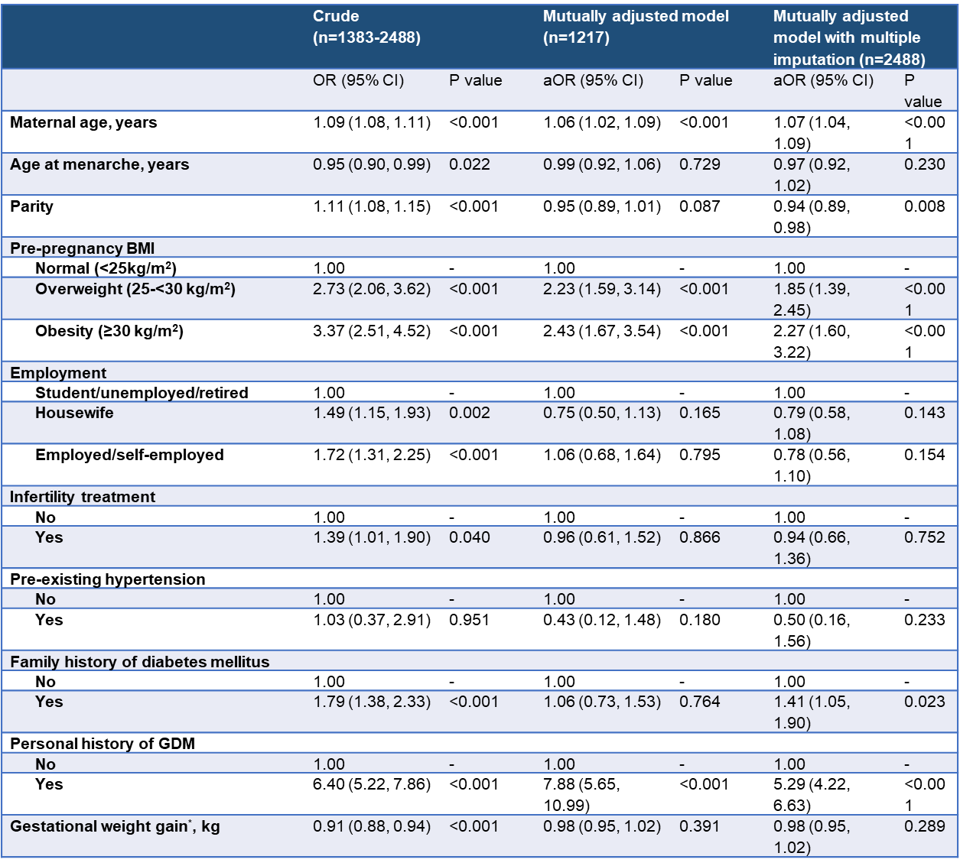
Burden and risk factors of gestational diabetes among Emirati population in the UAE: The Mutaba’ah Study
Nasloon Ali¹, Maryam M. Bashir¹ (Graduate student), Fatma Al Maskari^{1,2}, Iffat Elbarazi¹, Abderrahim Oulhaj^{1,2}, Rami H. Al-Rifai^{1,2}, Tom Loney³, Luai A. Ahmed^{1,2}*
1 Institute of Public Health UAEU Al Ain, 2 Zayed Centre for Health Sciences UAEU Al Ain, 3 College of Medicine MBRU Dubai, UAE
Introduction Gestational diabetes mellitus (GDM) is one of the causes of poor outcomes during pregnancy and later in life, both in mothers and children. Knowledge of GDM burden and its risk factors in a population is paramount for designing targeted preventive interventions in that population. There is currently a dearth of data on the burden of GDM in the Emirati population
Aims & Objectives To investigate the incidence of GDM in a large representative sample of pregnant Emirati women and identify associated risk factors
Materials & Methods All pregnant Emirati women who are aged 18years and above and can provide informed consent, are eligible to participate in The Mutaba’ah Study. This is a multicentre study where data is being obtained through questionnaires and medical data extraction from Al-Ain, Tawam and Kanad hospitals. This index study is an interim analysis of women who joined The Mutaba’ah Study between May 2017 and March 2020. Regression models assessed the relationship between risk factors and GDM
Results The analysis included 2,488 women, out of which 675 (27.1%) were diagnosed with GDM in their current pregnancies. For every year increase in maternal age, there is 6% increase in odds of developing GDM (adjusted odds ratio (aOR): 1.06, 95% CI 1.04-1.09). The odds of developing GDM also increased in pregnant women who previously had GDM (aOR: 5.39, 95% CI 4.29-6.77), those with a family history of diabetes (aOR: 1.41, 95% CI 1.05-1.91), who were pre-pregnancy overweight (aOR: 1.85, 95% CI 1.38-2.50) or obese (aOR: 2.32, 95% CI 1.63-3.29). Interestingly, parity showed an inverse association and seemed protective of GDM
Conclusion More than a quarter of women (1 in 4) in the Emirati population developed GDM during their index pregnancies, which is higher than the global and regional burden. Independent risk factors identified include maternal age, pre-pregnancy overweight and obesity, gestational weight gain, family history of diabetes, and history of previous GDM. Focusing on culturally appropriate pre-conception and pregnancy lifestyle interventions may help to reduce the incidence of GDM among Emirati population in the UAE
Crude and adjusted associations between potential risk factors and GDM among 2,488 pregnant Emirati women in Al Ain, UAE. The Mutaba’ah Study
GDM, gestational diabetes mellitus; OR, odds ratio; aOR, adjusted odds ratio; CI, confidence interval; BMI, body mass index; *Gestational weight gain at 0-24 gestational weeks.

